Slide 1
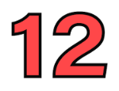
Divisibility
4
1
13 ÷ 3 = ___ , Remainder = ____
13 is not divisible by 3 because it has a remainder = 1

Slide 2
Divisibility
5
0
15 ÷ 3 = ___ , Remainder = ____
15 is divisible by 3 because it has a no remainder = 0

Slide 3
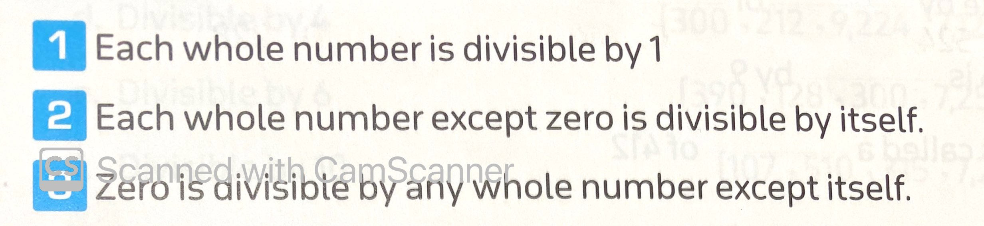
Notes:

